Slide 1
Visualization in R

Slide 2
Data Visualization
Data visualization is a technique used for the graphical representation of data.
Eg. scatter plots, charts, graphs, histograms, maps, etc.,
Make our data more understandable
Makes it easy to recognize patterns, trends, and exceptions in our data.
Enables us to convey information and results in a quick and visual way.

Slide 3
Data Visualization in R
Base Graphics
Grid Graphics
Lattice Graphics
ggplot2

Slide 4
Basic plots
The graphics package is used for plotting base graphs like scatter plot, box plot etc.
A complete list of functions with help pages can be obtained by typing :
library(help = "graphics")

Slide 5
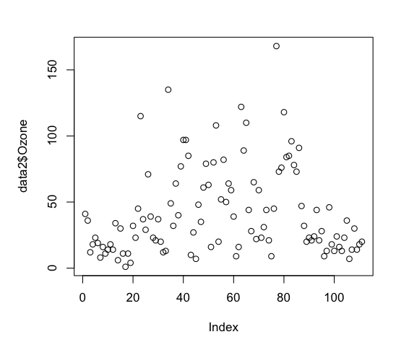
plot()
The plot() function is a kind of a generic function for plotting of R objects.
plot(dat$Ozone)
1D scatter plot

Slide 6
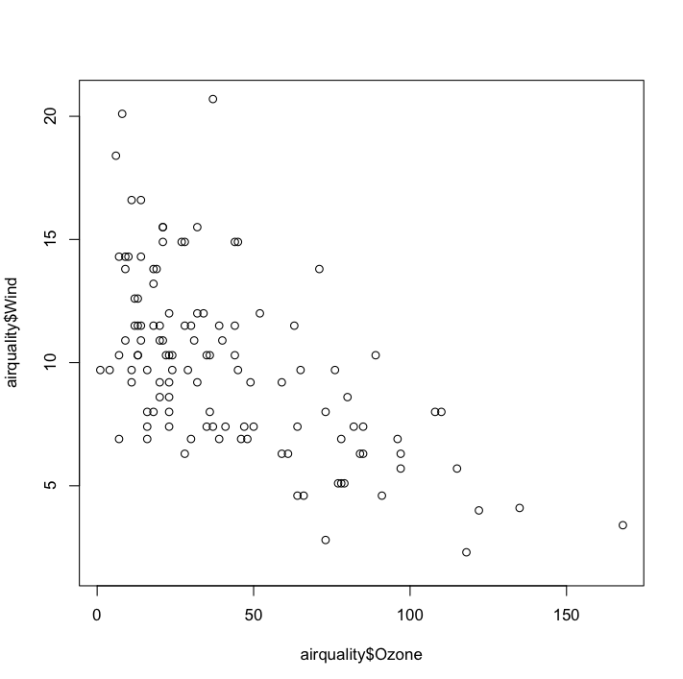
Scatter plot
Used to get relationship between two variables
To study the relationship between the Ozone and Wind values
plot(dat$Ozone, dat$Wind)
Negative Correlation

Slide 7
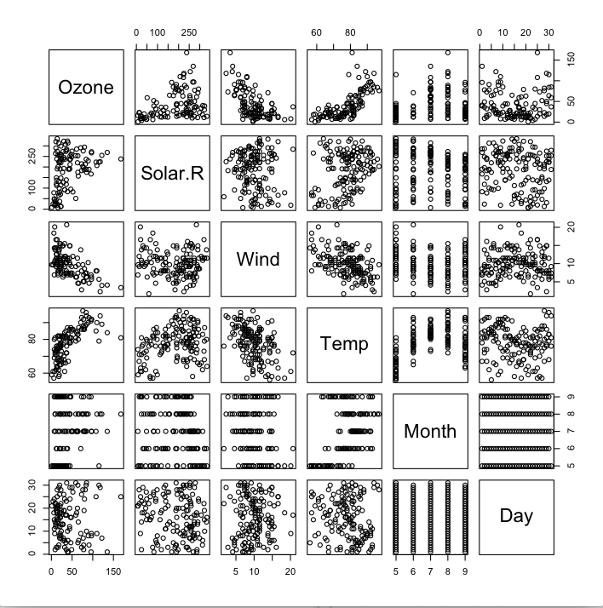
Scatter plot (contd.)
When plot command is used with the entire dataset, a matrix of scatterplots is obtained which is a correlation matrix of all the columns.
Ozone and Wind -Negative Correlation
Ozone and Temperature – Positive Correlation
Wind and Temperature – Negative Correlation

Slide 8
Argument in plot()
type argument
Take in values like p: points, l: lines,b: both etc. This decides the shape of the output graph.
h:high density lines

Slide 9
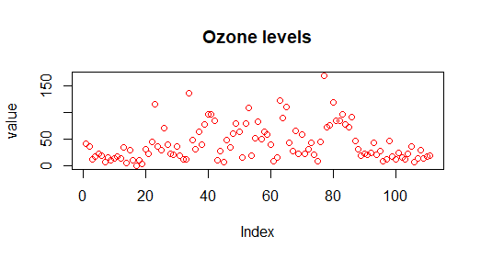
Argument in plot() – (contd.)
Titles & Labels
main argument – Title
xlab, ylab argurments– x-axis & y-axis label respectively

Slide 10
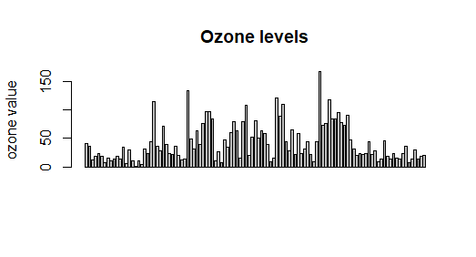
Bar plot
Data is represented in the form of rectangular bars
Length of the bar is proportional to the value of the variable
barplot(dat$Ozone, main = 'Ozone levels', ylab = 'ozone value')

Slide 11
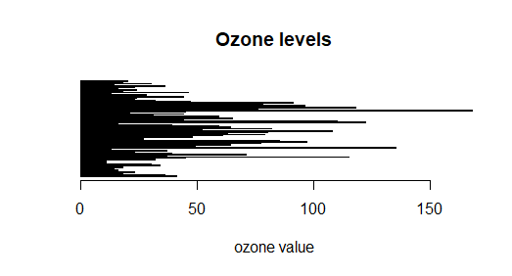
Bar plot (contd.)
Both horizontal, as well as a vertical bar chart, can be generated by tweaking the horiz parameter.
barplot(dat$Ozone, main = 'Ozone levels', xlab = 'ozone value',horiz = TRUE)

Slide 12
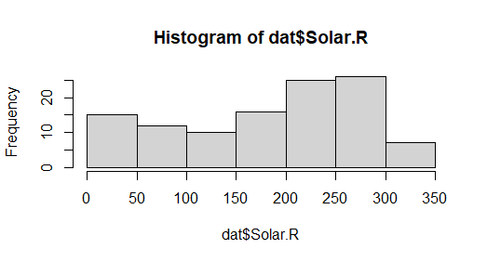
Histogram
Represents the frequencies of values of a variable bucketed into ranges
Similar to a bar chart except that it groups values into continuous ranges
hist(dat$Solar.R)

Slide 13
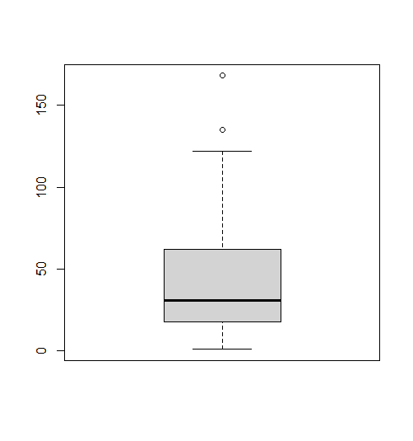
Box plot
Displays the descriptive statistics graphically in the form of quartiles
boxplot(dat$Ozone)
summary(dat$Ozone)
Min. 1st Qu. Median Mean 3rd Qu. Max.
1.0 18.0 31.0 42.1 62.0 168.0

Slide 14
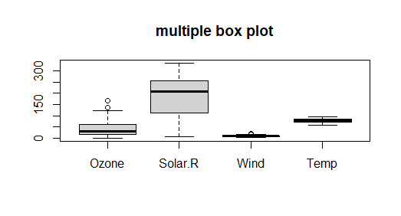
Box plot (Contd.)
Multiple box plot
boxplot(dat[,1:4],main='multiple box plot')

Slide 15
Grid of charts
Enables plotting multiple charts at once
For drawing a grid, the first argument should specify certain attributes like
the margin of the grid(mar)
no of rows and columns(mfrow)
whether a border is to be included(bty) and
position of the labels(las: 1 for horizontal, las: 0 for vertical).

Slide 16
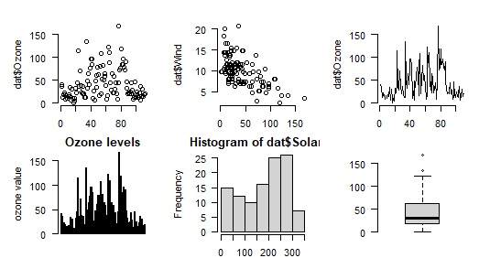
Grid of charts (contd.)
par(mfrow=c(2,3),mar=c(2,5,2,1),las=1, bty=‘n')
plot(dat$Ozone)
plot(dat$Ozone,dat$Wind)
plot(dat$Ozone,type ='l')
barplot(dat$Ozone, main = 'Ozone levels', ylab = 'ozone value')
hist(dat$Solar.R)
boxplot(dat$Ozone)

Slide 17
Lattice Graphs
Lattice package is used to visualize multivariate data.
Lattice enables the use of trellis graphs.
Trellis graphs exhibit the relationship between variables which are dependent on one or more variables.
library(lattice)

Slide 18
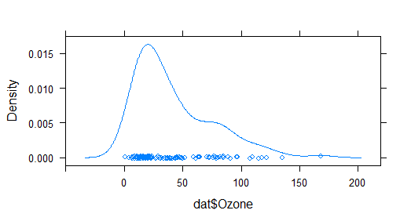
Lattice Graphs (contd.)
Kernel density plot
densityplot(dat$Ozone)

Slide 19
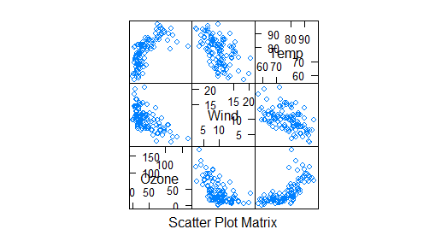
Lattice Graphs (contd.)
scatter plot matrix
splom(dat[c(1,3,4)])

Slide 20
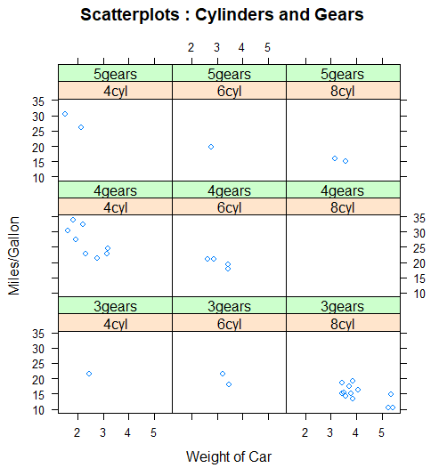
Lattice Graphs (contd.)
scatter plot depicting the combination of 2 factors
xyplot(mpg~wt|cyl_factor*gear_factor,
main="Scatterplots : Cylinders and Gears",
ylab="Miles/Gallon", xlab="Weight of Car")
#preprocessing
unique(gear)
gear_factor<-factor(gear,levels=c(3,4,5),
labels=c("3gears","4gears","5gears"))
unique(cyl)
cyl_factor <-factor(cyl,levels=c(4,6,8),
labels=c("4cyl","6cyl","8cyl"))

Slide 21
ggplot()
Stands for grammar of graphics
Introduced by Hadley Wickham, Winston Chang in the year 2007.
Used for creating elegant and more sophisticated visualization with little code
Builds graph in layers
build a a complex graph by starting with a simple graph and adding additional elements, one at a time

Slide 22
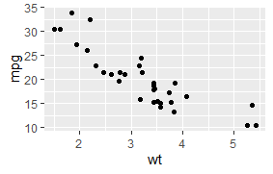
ggplot() –scatter plot
library(ggplot2)
ggplot(data = mtcars,
mapping = aes(x=wt,y=mpg))+geom_point()

Slide 23
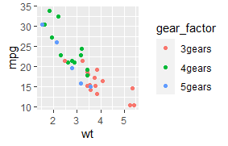
ggplot() –scatter plot (contd.)
Grouping – Allows plotting multiple variables in a single graph
Split the plot with factor variable using color paramerter
ggplot(mtcars,aes(x=wt,y=mpg,color=gear_factor))+geom_point()

Slide 24
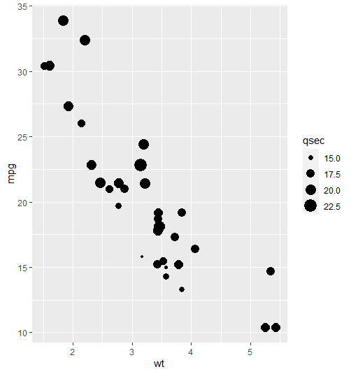
ggplot() –scatter plot (contd.)
Split the plot with factor variable using size paramerter
ggplot(mtcars,aes(wt,mpg,size=qsec))+geom_point()
The value of qsec indicates the acceleration which decides the size of the points

Slide 25
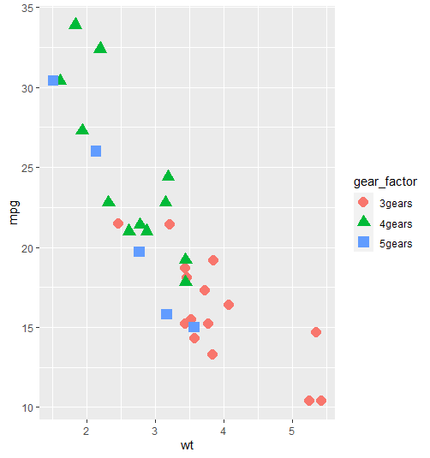
ggplot() –scatter plot (contd.)
Differentiating the data with both shape and color
ggplot(mtcars,aes(wt,mpg,shape=gear_factor))+geom_point(aes(color=gear_factor),size=4)

Slide 26
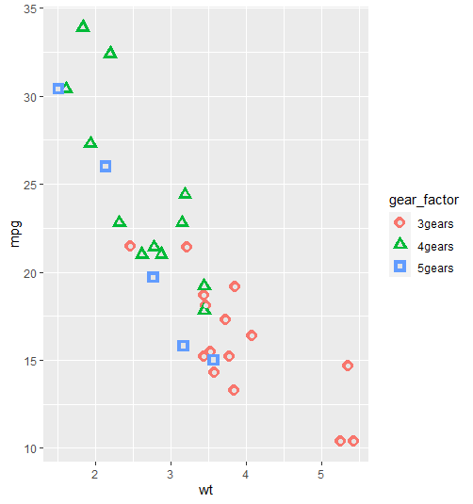
ggplot() –scatter plot (contd.)
Adding layers
ggplot(mtcars,aes(wt,mpg,shape=gear_factor))+geom_point(aes(color=gear_factor),size=4) +geom_point(color='grey90',size=1.5)

Slide 27
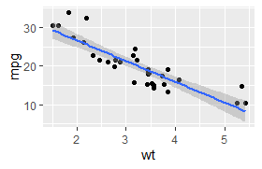
ggplot() –scatter plot
Adding best fit line
ggplot(data = mtcars,mapping = aes(x=wt,y=mpg))+ geom_point()+ geom_smooth(method = 'lm')

Slide 28
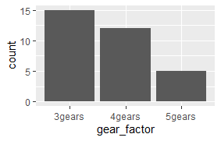
ggplot –bar plot
plotting the distribution of cylinder
ggplot(mtcars,aes(x=gear_factor))+geom_bar()

Slide 29
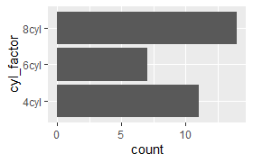
ggplot –bar plot
plotting the distribution of cylinder – flipping the bar direction
ggplot(mtcars,aes(x=gear_factor))+geom_bar()+coord_flip()

Slide 30
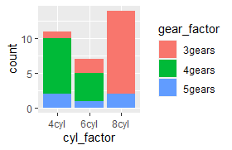
ggplot –bar plot – 2 variables
plotting the distribution of cylinder and gears as stacked bar
ggplot(mtcars,aes(x=cyl_factor,fill=gear_factor))+geom_bar(position = "stack")

Slide 31
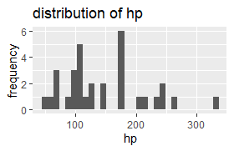
ggplot –histogram
plotting the distribution of hp (horse power)
ggplot(mtcars,aes(x=hp))+geom_histogram()+labs(title='distribution of hp',y='frequency')

Slide 32
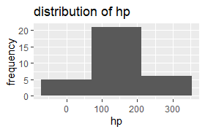
ggplot –histogram
plotting the distribution of hp (horse power)- change the no.of bins
ggplot(mtcars,aes(x=hp))+geom_histogram(bins = 3)+labs(title='distribution of hp',y='frequency')

Slide 33
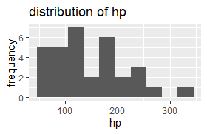
ggplot –histogram
plotting the distribution of hp (horse power) – can change the binwidth
ggplot(mtcars,aes(x=hp))+geom_histogram(binwidth = 30)+labs(title='distribution of hp',y='frequency')

Slide 34
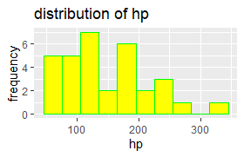
ggplot –histogram
plotting the distribution of hp (horse power) – can specify border and fill color
ggplot(mtcars,aes(x=hp))+geom_histogram(binwidth = 30,color='green',fill='yellow')+labs(title='distribution of hp',y='frequency')

Slide 35
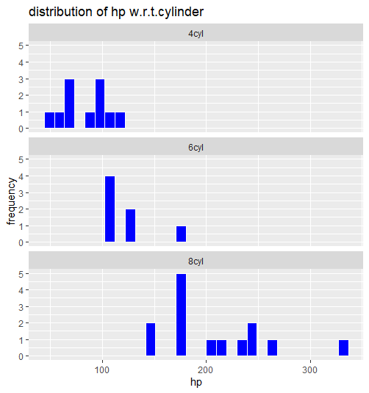
ggplot –histogram
Faceting – A graph consisting of several plots
plotting the distribution of hp (horse power) based on cylinder values (cyl)
ggplot(mtcars,aes(x=hp))+
geom_histogram(fill='blue',color='white')+
facet_wrap(cyl_factor,ncol=1)+
labs(title='distribution of hp w.r.t.cylinder',y='frequency')

Slide 36
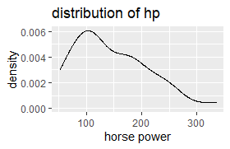
ggplot –Kernel density curve
Plotting the kernel density curve of hp (horse power)
ggplot(mtcars,aes(x=hp))+geom_density()+
labs(x="horse power",y="density",title="distribution of hp")

Slide 37
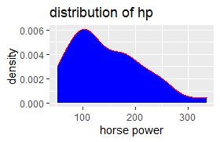
ggplot –Kernel density curve
Plotting the kernel density curve of hp (horse power) – fill with yellow color
ggplot(mtcars,aes(x=hp))+geom_density(fill='blue',color='red')+
labs(x="horse power",y="density",title="distribution of hp")

Slide 38
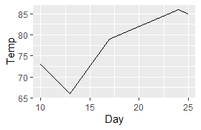
ggplot – line plot
Line plot of Days vs. Temp in airquality dataset which is read in dat dataframe
dat1 <- dat[sample(nrow(dat),5),] # sampling random 5 rows
ggplot(dat1,aes(x=Day,y=Temp))+geom_line()

Slide 39
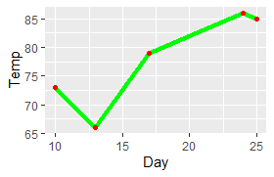
ggplot – line plot
Line plot of Days vs. Temp in airquality dataset which is read in dat dataframe
With varied thickness and color with points
ggplot(dat1,aes(x=Day,y=Temp))+geom_line(size=1.5,color='green')+geom_point(size=1.5,color='red')

Slide 40
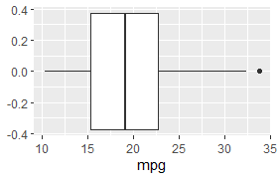
ggplot – box plot
Box plot showing the summary statistics of miles per gallon (mpg) variable
ggplot(mtcars,aes(x=mpg))+geom_boxplot()

Slide 41
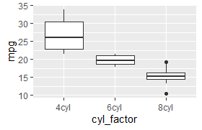
ggplot – box plot
Box plot showing the summary statistics of miles per gallon (mpg) variable for varied cylinder (cyl) values
ggplot(mtcars,aes(x=cyl_factor,y=mpg))+geom_boxplot()

Slide 42
Reference
https://towardsdatascience.com/a-guide-to-data-visualisation-in-r-for-beginners-ef6d41a34174#c517
https://rkabacoff.github.io/datavis/Univariate.html#categorical
https://www.analyticsvidhya.com/blog/2015/07/guide-data-visualization-r/
https://intellipaat.com/blog/tutorial/r-programming/data-visualization-in-r/

